Slide 1


Table of Content
Introduction to Automation
Role & Benefits of Automation in Industry
Challenges faced by the manufacturing industry in Manual
Process
Electronics and Communication Engineering – 20EC53I

Slide 2
Introduction to Automation
The word automation comes from the Greek word “automatos,” meaning self-acting.
Automation is a set of technologies that results in operation of a system without significant human intervention and achieves performance superior to manual operation
Industrial Automation is a process of operating machines and other industrial equipment with the help of digital logical programming (PLC) and reducing human intervention in decision making and manual command process with the help of mechanized equipment.
Electronics and Communication Engineering – 20EC53I

Slide 3
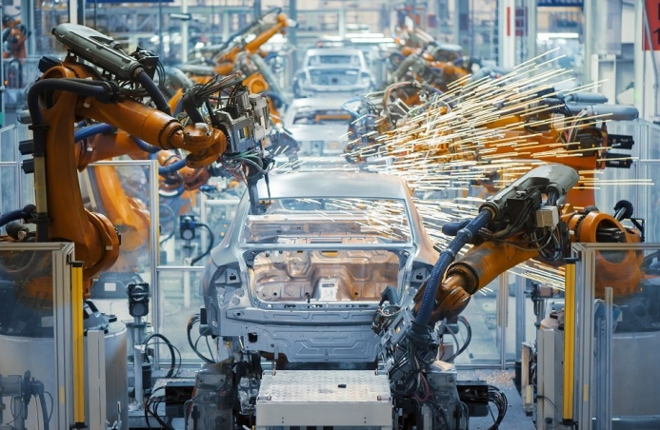
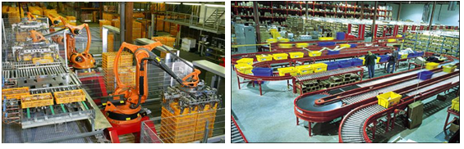
Introduction to Automation
Samples of Industrial Automation
Electronics and Communication Engineering – 20EC53I

Slide 4
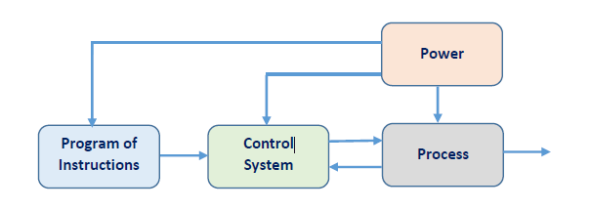
Introduction to Automation
Basic Components of Automation System
Electronics and Communication Engineering – 20EC53I

Slide 5
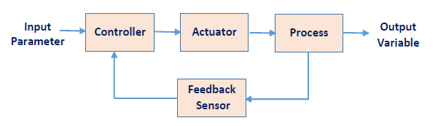

Introduction to Automation
Control System
A feedback Control System
An Open Loop Control System
Electronics and Communication Engineering – 20EC53I

Slide 6
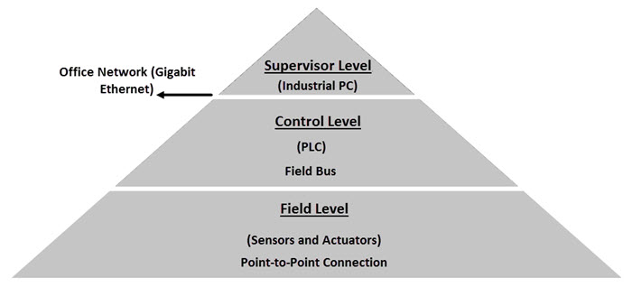
Introduction to Automation
Levels of Industrial Automation Process
Electronics and Communication Engineering – 20EC53I

Slide 7
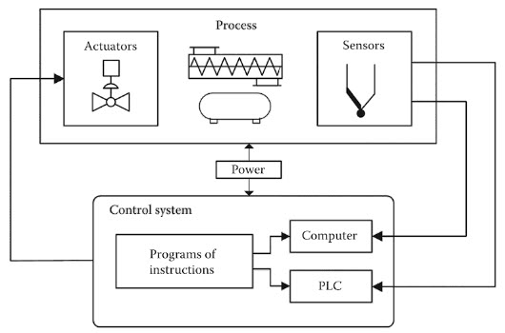
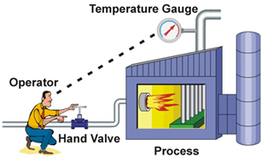
Introduction to Automation
Example to Understand Industrial Automation
Manual Process
Automated Process
Electronics and Communication Engineering – 20EC53I

Slide 8
Role and Benefits of Automation in Industry
Increase in Productivity
Enhances Quality
Greater consistency
Flexibility
More precise information
Promotes Industrial Safety
Cost reduction
More efficient material use
Predictive maintenance
Increase in human efficiency
Electronics and Communication Engineering – 20EC53I

Slide 9
Challenges faced by the manufacturing industry in Manual Process
Demand Forecasting
Inventory Management & Control
Efficiency Issues At Manufacturing Plants
Time Consuming
Room for Errors
Additional Cost Incurred on Training Staff
Dilution of Information
Lack of Safety and Security
Electronics and Communication Engineering – 20EC53I

Slide 10
Video documentary of BMW car production industry
https://www.youtube.com/watch?v=aGQF5RvByNE
2022 BMW 5 Series DE PRODUCTION (German Car Factory)
Electronics and Communication Engineering – 20EC53I

Slide 11
Assessment Questions
1. Industrial Automation belongs to ?
(a) Mechanical Engineering
(b) Electrical Engineering
(c) Computer Science Engineering
(b) All the above
Electronics and Communication Engineering – 20EC53I

Slide 12
Assessment Questions
1. Industrial Automation belongs to ?
(a) Mechanical Engineering
(b) Electrical Engineering
(c) Computer Science Engineering
(b) All the above
Electronics and Communication Engineering – 20EC53I

Slide 13
Assessment Questions
2. PLC stands for ?
(a) Programmable Logic Carry
(b) Programmable Logic Controller
(c) Programmable Lead Company
(b) Programmable Lock Controller
Electronics and Communication Engineering – 20EC53I

Slide 14
Assessment Questions
2. PLC stands for ?
(a) Programmable Logic Carry
(b) Programmable Logic Controller
(c) Programmable Lead Company
(b) Programmable Lock Controller
Electronics and Communication Engineering – 20EC53I

Slide 15
Assessment Questions
3. Components of Automation ?
(a) Sensors
(b) Actuators
(c) Controllers
(b) All the above
Electronics and Communication Engineering – 20EC53I

Slide 16
Assessment Questions
3. Components of Automation ?
(a) Sensors
(b) Actuators
(c) Controllers
(b) All the above
Electronics and Communication Engineering – 20EC53I

Slide 17
Assessment Questions
4. Sensors and Actuators are belongs to ?
(a) Supervisor Level
(b) Control Level
(c) Field Level
(b) Ground Level
Electronics and Communication Engineering – 20EC53I

Slide 18
Assessment Questions
4. Sensors and Actuators are belongs to ?
(a) Supervisor Level
(b) Control Level
(c) Field Level
(b) Ground Level
Electronics and Communication Engineering – 20EC53I

Slide 19
Assessment Questions
5. Benefits of Industrial Automation
(a) Increase in Productavity
(b) Enhances Quality
(c) Cost Reduction
(b) All the above
Electronics and Communication Engineering – 20EC53I

Slide 20
Assessment Questions
5. Benefits of Industrial Automation
(a) Increase in Productavity
(b) Enhances Quality
(c) Cost Reduction
(b) All the above
Electronics and Communication Engineering – 20EC53I

